Slide 1
Password based garage door Under the guidance of Dr.Sumit Gupta Asst.Prof. Department of ECE
Team-4
2003A51182 G. Shiva sai
2003A51150 K. Goutham reddy
2003A51188 N.Vivek naik
2003A51213 S.Benjamen

Slide 2
Abstract
Now a day’s most of the systems are automated in order to face new challenges and present day requirements to achieve good results. Automated systems have less manual operations so that the flexibility, reliabilities are high and accurate.
Electronic locking systems are preferable over mechanical locks, to resolve the security problems that are associated with the mechanical locks This system uses Android technology for opening and closing operations. Hence, users can use their Android mobiles for door operations instead of using a keypad.

Slide 3
Introduction
This project is designed to unlock a garage door with an Android device by entering a single password in an Android application. An Android OS-based device, such as a mobile or tablet, is connected to this system through a Bluetooth device.
The Bluetooth device is attached to the microcontroller, which is programmed with a particular password for opening and closing the garage door by its owner. An android application with a Graphical User Interface based touch screen

Slide 4
Problem statement
Basically traditional locks are heavy and are not protective as they can be broken down easily by using some tools. electronic locking system are preferable over mechanical locks, to resolve the security problems that are associated with the mechanical locks

Slide 5
Proposed work
John Smith
Business Analyst
yourname@yourwebsite.com
Password based garage door:
In this project, we are going to monitor the status of a door using an ESP32 board we will receive a message in your Telegram account whenever the garage door changes state: opened or closed and car arrival status.
As long as you have access to the internet on your smartphone, you’ll be notified no matter where you are.
The ESP32 board will be programmed using Arduino IDE.In this password based locking system , the micro controller is connected telegram bot the message from telegram are used to open and close the door.

Slide 6
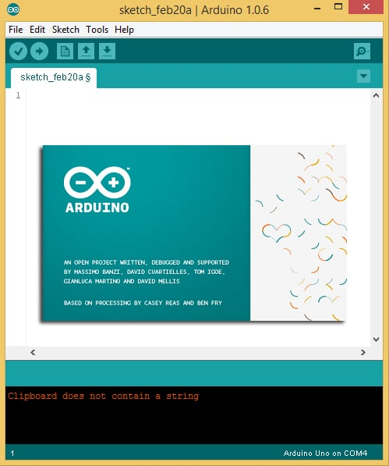
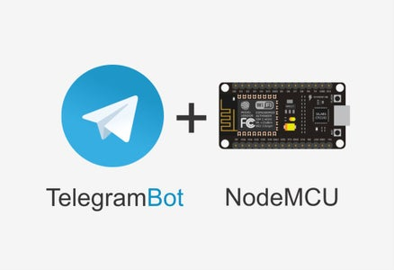
Hardware and software tools
Software tools:
Arduino Ide
Telegram Bot

Slide 7
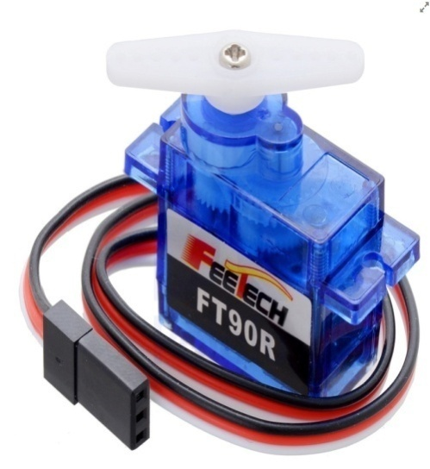
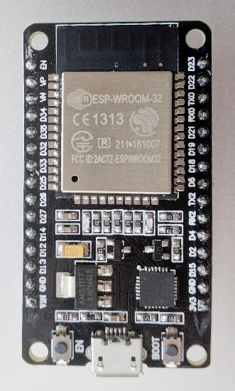
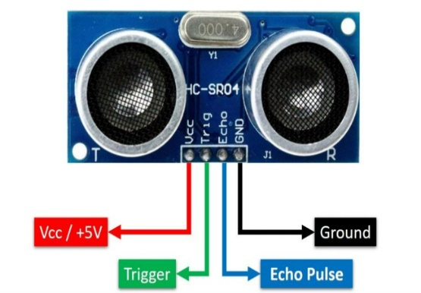
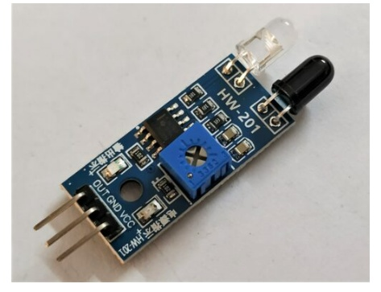
Hardware and software tools
Hardware tools:
ESP32
Ultra sonic sensor
IR sensor
Micro servo

Slide 8
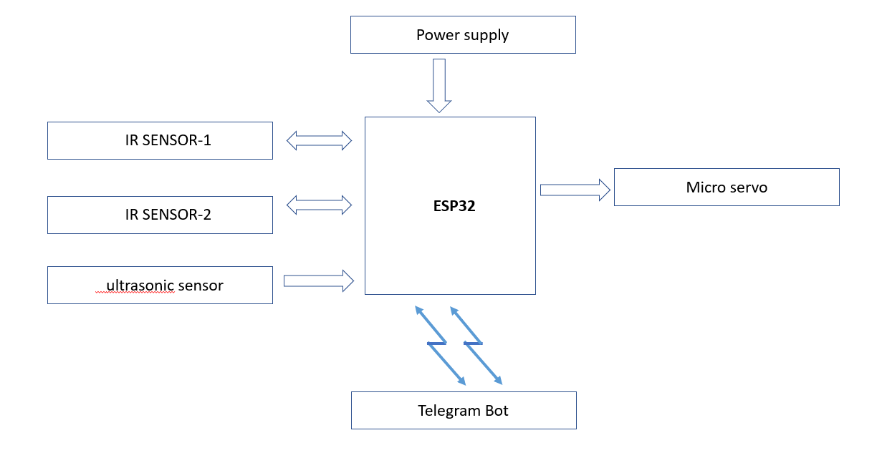
Block diagram

Slide 9
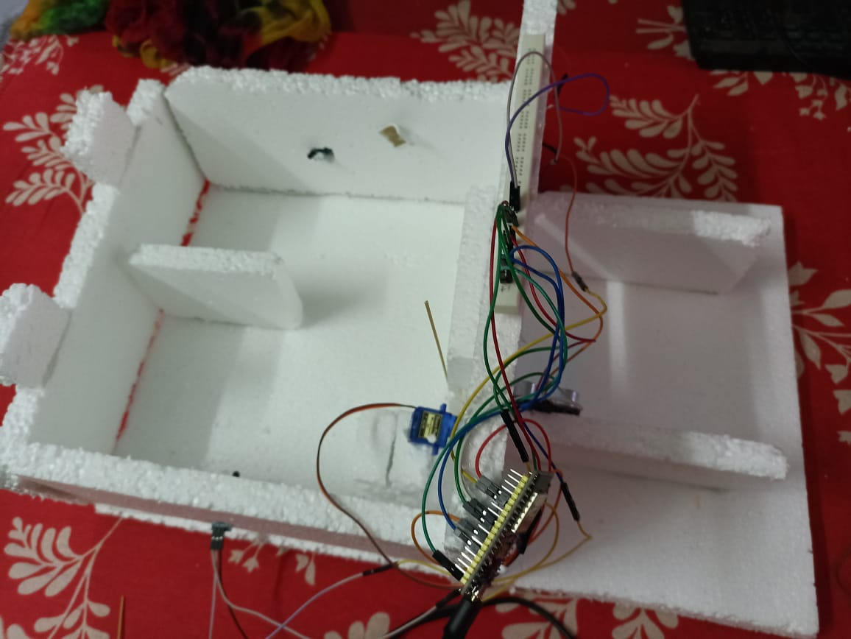
Photos of the project

Slide 10
conclusion
The main objective of this project is to unlock a garage door by an android application using a unique password entered through the android application device.
Opening and closing of garage door involves human labor. In this proposed system, the opening and closing of a garage door is achieved by using an android application.

